Slide 1
Business Analytics Case Study: Telco Customer Churn Analysis
Subtitle:
Identifying Factors Influencing Customer Attrition
Prepared by:
Tinotenda Chadzingwa
Program:
AnalystLab Africa – Data Analytics Internship
Week 5: Business Analytics Case Study

Slide 2
Problem Statement
Content:
Customer churn is a major challenge for telecommunication companies as it leads to revenue loss and reduced customer loyalty.
Understanding why customers leave is essential for improving retention strategies and customer satisfaction.
Objective:
Analyze customer data to identify the key factors influencing customer churn and provide actionable business recommendations.

Slide 3
Dataset Overview
Content:
Dataset: Telco Customer Churn Dataset
Source: Kaggle
Dataset Summary:
Original Records: 7,043
Cleaned Records: 7,032
Features: 21 variables
Target Variable: Churn (Yes/No)
Tools Used:
Python
Pandas
Matplotlib
Seaborn
Power BI

Slide 4
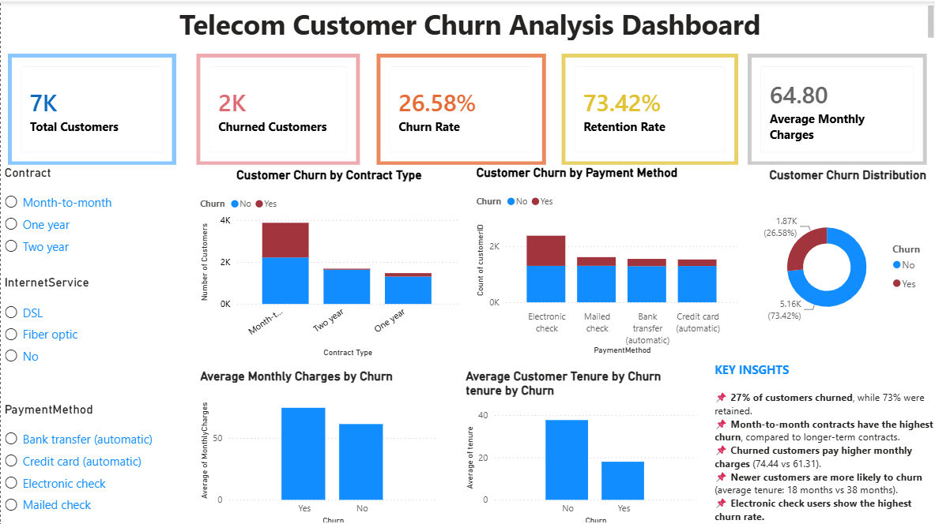
Key Visualizations
KPI cards summarize customer churn and retention metrics.
Interactive visuals compare churn across contract types, payment methods, tenure, and monthly charges.
Slicers allow users to filter and explore customer segments dynamically.
The dashboard provides a comprehensive view of the key drivers of customer churn.

Slide 5
Major Findings
Approximately 26.6% of customers churned, while 73.4% were retained.
Customers on month-to-month contracts had the highest churn rates.
Customers paying higher monthly charges were more likely to leave.
Customers with shorter tenure showed a higher likelihood of churning.
Electronic check users experienced the highest churn among payment methods.

Slide 6
Recommendations
Encourage customers to switch to longer-term contracts through incentives.
Improve onboarding and engagement for new customers.
Review pricing plans to ensure customers receive good value.
Improve payment options and customer experience.
Develop targeted retention campaigns for high-risk customer segments.

Slide 7
Conclusion
The analysis identified contract type, tenure, monthly charges, and payment method as the primary drivers of customer churn.
These insights can support data-driven decision-making and help the company reduce churn through targeted retention strategies.

